Slide 1
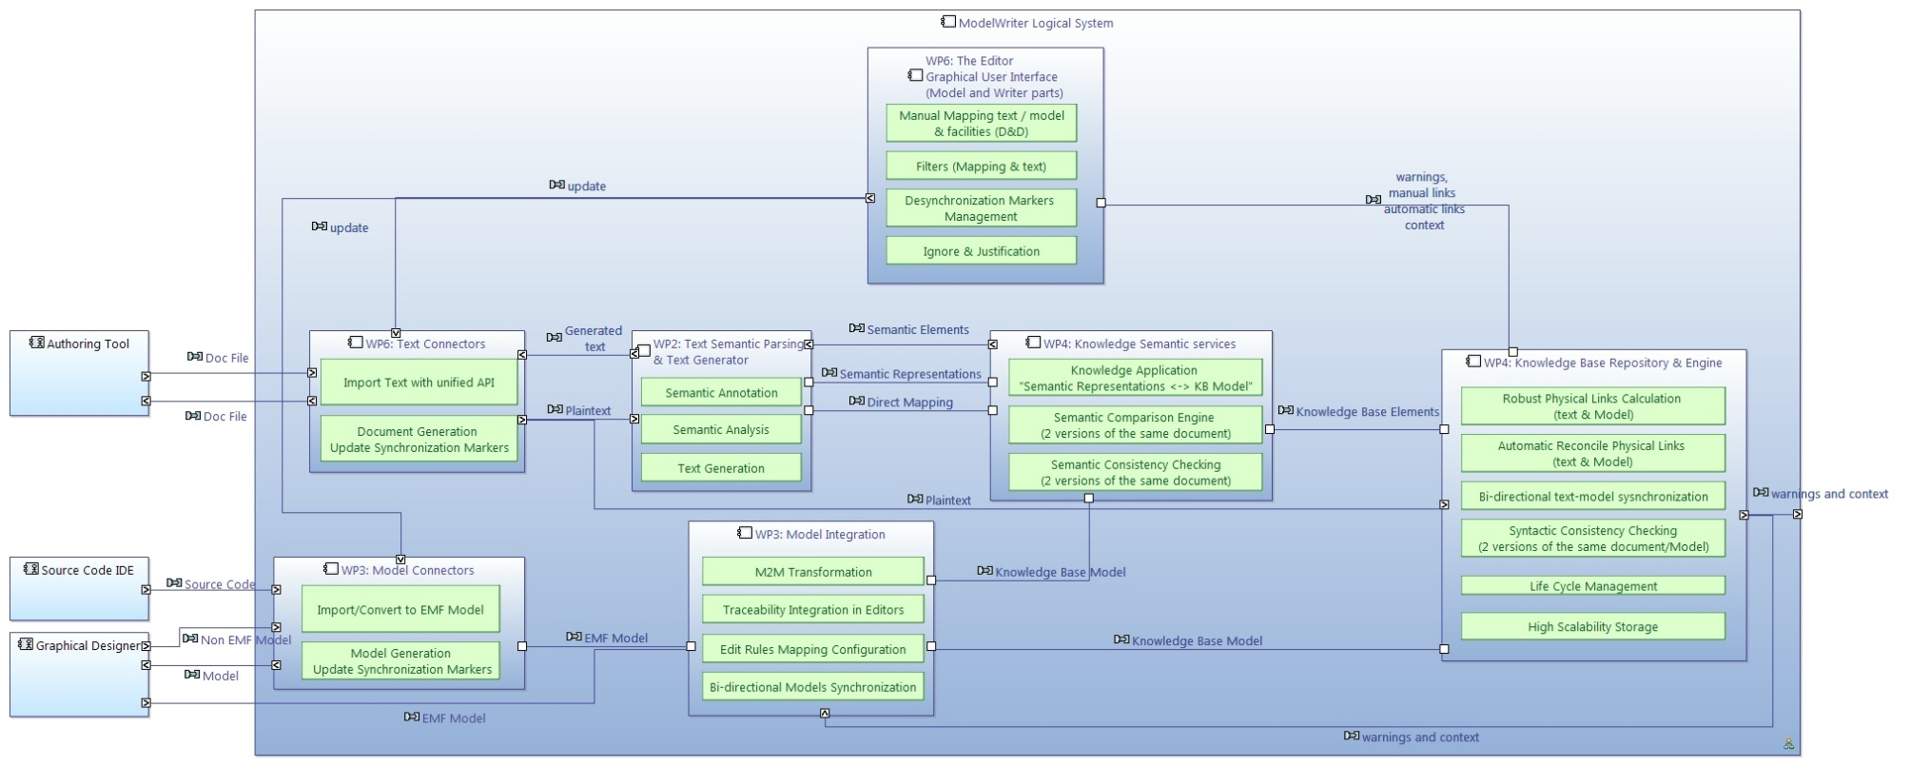
WP6 ModelWriter Functional Architecture

Slide 2
WP6 Text connectors

Slide 3
WP6 Model connectors

Slide 4
WP6 Text semantic parsing and text generator

Slide 5
WP6 Model Integration

Slide 6
WP6 Knowledge Semantic services

Slide 7
WP6 Knowledge base repository and engine

Slide 8
WP6 Editors and GUI (Model and Writer parts)

Slide 9
WP6 Integration
Source code
Github repository
Checkstyle and code templates
Target platforms
Continuous integration
Next steps
Jenkins
Provide an update site and an Eclipse product
integrate existing components
Ease the release process

Slide 10
WP6 Evaluation
Unit testing
JUnit
Code coverage (Eclemma)
Integration testing
Use cases
Jenkins will run all tests on a daily basis
Functional testing via GUI (RCPTT)
Milestone functional testing
Drives features and enhancements

